Slide 1
Active Guard
Reserve (AGR)
Pre-Retirement Briefing

Slide 2
Agenda
Definitions and Acronyms
Types of Retirements
Review your Documents
1405 Time
Survivor Benefit Plan (SBP)
Retired Pay Systems
Retirement Process
Medical Retirements
Deferred Retirements
Website Resources

Slide 3
Definitions and Acronyms
Definitions
  Active Service means service on active duty or
  full-time National Guard duty.
  Active Status means the status of a member of a reserve component who is not in the inactive Army National Guard or inactive Air National Guard, on an inactive status list, or in the Retired Reserve.
Acronyms
  DIEMS – Date Initial Entry Military Service
  BASD – Basic Active Service Date
Notes:
Definitions: Reference Title 10, USC Chapter 1, section 101
Terms
DEIMS – Date Initial Entry Military Service
This is the date used to determine what Retired Pay System a Soldier is eligible to receive.
BASD – Basic Active Service Date
This date is the Soldier’s total active service calculated as if there was no break in active service. While the Soldier is in an Active Service status, this will show up on the Soldier’s RPAM statement. If there is no further break in active service, this date plus 20 years is when the Soldier will be eligible for an active service retirement.
An Active Service Retirement gives the Soldier immediate retired pay and full retirement benefits (TRICARE, Tricare for Life, etc.)
Non-Regular Retirement is a reserve service retirement for which the Soldier must be issued a Notice of Eligibility (either 20 year or 15 year). Retired pay and TRICARE benefits do not start until the Soldier meets the Retired Pay Date of Eligiblity (RPED) which is typically age 60.
Eligibility for an active service retirement prohibits a Soldier from receiving a non-regular retirement except under the provisions of Title 10 USC section 12741. This provision allows a Soldier who has already met eligibility for an active service retirement and has served in an active status of the Selected Reserve of the Ready Reserve (National Guard Drilling Soldier, TPU Drilling Soldier, Active IRR Control Group (with at least 50 points per year) for a minimum of two years (not including active serve – AT, ADOS, School, etc.) to elect at their RPED to receive retired pay under the non regular retirement instead of active service.
- Why would they do this? To receive retired pay at the highest grade held versus the highest grade held on active service. (example, O6 promoted to O7 as ATAG, SFC reaches RCP and REFRADS to be traditional Soldier then is promoted to MSG)

Slide 4
Types of Military Retirements
Types of Retirements
Regular
Non-Regular (15 or 20 year)
10 USC 12741
Notes:
An Active Service Retirement gives the Soldier immediate retired pay and full retirement benefits (TRICARE, Tricare for Life, etc.)
Non-Regular Retirement is a reserve service retirement for which the Soldier must be issued a Notice of Eligibility (either 20 year or 15 year). Retired pay and TRICARE benefits do not start until the Soldier meets the Retired Pay Date of Eligiblity (RPED) which is typically age 60.
Eligibility for an active service retirement prohibits a Soldier from receiving a non-regular retirement except under the provisions of Title 10 USC section 12741. This provision allows a Soldier who has already met eligibility for an active service retirement and has served in an active status of the Selected Reserve of the Ready Reserve (National Guard Drilling Soldier, TPU Drilling Soldier, Active IRR Control Group (with at least 50 points per year) for a minimum of two years (not including active serve – AT, ADOS, School, etc.) to elect at their RPED to receive retired pay under the non regular retirement instead of active service.
- Why would they do this? To receive retired pay at the highest grade held versus the highest grade held on active service. (example, O6 promoted to O7 as ATAG, SFC reaches RCP and REFRADS to be traditional Soldier then is promoted to MSG)

Slide 5
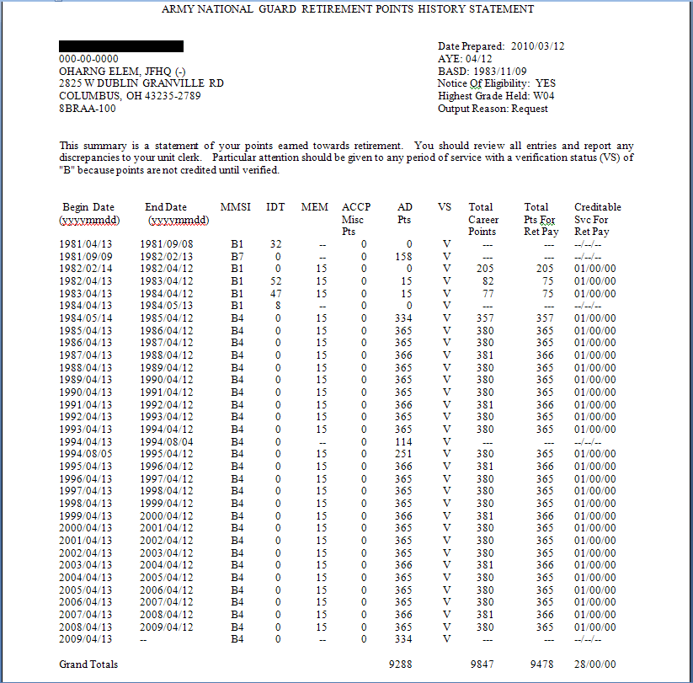
Review your Documents
20 years of Active Federal Service from this date = Active Duty Retirement!
DIEMS Date
M-day Soldiers w/over
6480 AD pts might be
eligible for Sanctuary if
put on orders and those
w/over 7200 might be
Regular Retirement eligible.
Notes:
5

Slide 6
1405 Time
1405 Time – IDT points earned while a member of the Reserve Component that is used to increase the multiplier of a Regular retirement.
May only be used AFTER acquiring 20 years of AS
It will not be used to create 20 years of AS, except for medical retirements.
Notes:
Time served as a traditional drilling Soldier is also used to increase an AGR Soldiers retirement. Once an AGR reaches 20 yrs of AFS, they are
then allowed to go back and receive credit for their IDT points. (IDT, Membership and ACCP Column of the NGB Form 23B is where you will
find these points, the maximum points allowed per retirement year is still applicable to this, as well.)

Slide 7
1405 Time
1405 points can be added only up to the maximum IDT points allowed per year!
1405 Time
Notes:
7

Slide 8
1405 Time Calculation Example
IDT MEM ACCP TOTAL 1405 points
810413 – 820412 32 15 0 47
820413 – 830412 52 15 0 60 (67) Only 60 count
830413 – 840412 47 15 0 60 (62)Only 60 count
840412 – 840513 8 15 0 23 *
Total: 190
190 Days = 6 months and 10 days can be added to active service time for retired pay multiplier.
* All 15 membership points count because member had less than 365 (or 366) AD points for the retirement year.
Notes:
As you can see, this individuals retirement was increased by 1.25% for the 6 months of 1405 time he had as a traditional drilling Soldier.
The RPAM system has a printout called “1405 Worksheet” that your RPAM NCO can pull up for you but beware it is not always correct. It will help point you in the right direction though and is worth looking into to help you calculate your retired pay correctly. You will want to ensure that this information is calculated correctly when you out process at the transition point.

Slide 9
Survivor Benefit Program
Retired pay stops when you pass away!
A government subsidized program that allows for up
to 55% of retired pay to be provided as a monthly
annuity to immediate dependents.
Six Categories of coverage:
* Spouse * Former Spouse
* Spouse and Children * Former Spouse and Child(ren)
* Child(ren) Only * Insurable Interest

Slide 10
RC-SBP and SBP
RC-SBP
90 days suspense from date of receiving NOE
  Automatic elections are:
Married – Option C, Full Coverage
No dependents – Option A, No coverage
If you later qualify for a Regular Retirement, RC-SBP becomes void and will not incur a cost!
SBP
Automatic coverage while on AD and permanent after 20 yrs AS
No premiums charged until retired pay is received, if elected

Slide 11
Types of Retired Pay Systems
Final Base Pay = joined prior to 8 Sep 80
High Three = joined between 8 Sep 80 – 31 Jul 86
CSB/REDUX = joined on 1 Aug 86 or after
Creditable status includes:
DEP, ROTC, Military Academy, and Health Professions
Scholarship Program

Slide 12
Final Base Pay Formula
DIEMS is prior to 8 Sep 80
Years of Service x 2.5% x final base pay = $ Retired Pay
Retired pay is calculated against the amount of the base pay at retirement
  Multiplier is 2.5% per year of active service plus 1405 time
  COLA is at full rate as determined by the Consumer Price Index

Slide 13
High Three Average Formula
DIEMS is between 8 Sep 80 – 31 Jul 86
Or AGR member eligible for REDUX declined the Career Status Bonus
Years of Service x 2.5% x average 36 mo base pay = $ Retired Pay
Retired pay is calculated against the average of the member’s highest 36 months of base pay
  Multiplier is 2.5% per year of active service plus 1405 time
  COLA is at full rate as determined by the Consumer Price Index

Slide 14
REDUX Formula
DIEMS is 1 Aug 86 or later
AGR member accepted the Career Status Bonus ($30,000) at 15 years of active service
Retired pay is calculated against the average of the member’s highest 36 months of base pay
  Multiplier is based on:
  First 20 years multiplied by 2.0%
  Each year after 20 until 30 multiplied by 3.5%
  Reverts to 2.5% after 30 years
COLA is 1% less than the full rate as determined by the Consumer Price Index
  One time catch up at age 62

Slide 15
AGR RETIREMENT PROCESS
WITHIN 1 YEAR OF RETIREMENT DATE (TAP/ACAP WORKSHOP)
1 Year out: (GATHER CIV-MIL MED DOCS/UPDATE DA 201)
1 Year out: (SUBMIT RETIREMENT REQUEST)
6 MONTH WINDOW
(Not less than 90 days prior to Retirement!)
ACCELERATED VA PROCESSING (If Available in your state)
And MEDICAL OUT PROCESSING
OUT PROCESS AT
TRANSITION CENTER w/ Spouse
(OUT THE DOOR) (PTDY up to
20 days granted by Command)
(TRANSITIONAL LEAVE)
(RETIRE)

Slide 16
Disability Separation or Retirement Process
Medical Retirements
AGR Soldiers with 20 years of Active Service are qualified for a length of Service Retirement and SHOULD NOT process for a Disability Retirement!
Loss of benefits
  Concurrent Retired and Disability Pay
  The VA cannot compensate for disability compensated by the military.

Slide 17
ARNG Soldiers Options at time of Disability Rating
ARNG Soldiers with 20 year NOE but less than 20 years Active Service
  20% or less disability
    Take Severance and waive retired pay and benefits at age of eligibility
    Waive Severance to take non-regular retired pay at the age of eligibility
  30% or greater disability
    TDRL/PDRL
    Apply for Non-Regular Retirement at age of eligibility to receive CRDP – Notify DFAS

Slide 18
ARNG Soldiers Options at time of Disability Rating
ARNG Soldiers with 15 year NOE eligibility
  15 year NOE must be requested when found medically unfit
  20% or less disability
    Take Severance and waive retired pay and benefits at age of eligibility
    Waive Severance to take non-regular retired pay at the age of eligibility
  30% or greater disability
    TDRL/PDRL
    Cannot receive CRDP (excluded because not eligible for a length of service retirement)

Slide 19
Severance Pay Vs. Non-Regular Retirement
Severance Pay Benefits
+ Upfront retired pay lump sum
(If VA disability payment is
received, the disability
severance payment could be
recouped from the Soldier)
This payment will go away
for most cases with the
implementation of the
Integrated Disability Evaluation
System (IDES)
Non-Regular Retirement Benefits
ID Card (Retiree/Family Members)
Commissary/MWR
Gray Area TRICARE Retired Reserve
TRICARE Retiree Dental Plan
Retired Pay at Age 60 (or earlier)
RC-SBP/SBP
VA Disability (CRSC/Concurrent
  Receipt may be available)
+ TRICARE/TRICARE for Life
(Retiree/Family Members)
+ Space-A Travel
Notes:
IDES will eliminate the disability separation payment because the VA disability rating will be received at the same time as the disability severance finding.
In most cases, the Soldier will not receive disability severance pay from the Military because the VA disability benefit compensation will exceed what he is rated by the Military and the Military money would have to be recouped for the Soldier to get his VA compensation.
Exception is in cases where the disability was incurred in the line of duty in a combat zone or incurred during performance of duty in combat-related operations as designated by the Secretary of Defense.

Slide 20
Active Service Retirement vs. MEB
Question:
What happens if a Soldier with an approved retirement has a medical issue requiring care past their retirement date
Example
    An AGR Soldier is approved for retirement and then finds out that he needs back surgery that will require physical therapy after retirement
    The injury has not kept the Soldier from performing his duties up to this point
    Does his retirement processing stop ?
    Does he need an MEB?

Slide 21
Active Service Retirement vs. MEB
Per AR 635-40 Physical Evaluation for Retention, Retirement or Separation:
Paragraph 3-2 b. Processing for separation or retirement from active service.
(1) Disability compensation is not an entitlement acquired by reason of service-incurred illness or injury; rather, it is provided to Soldiers whose service is interrupted and they can no longer continue to reasonably perform because of a physical disability incurred or aggravated in service.
(2) When a Soldier is being processed for separation or retirement for reasons other than physical disability, continued performance of assigned duty commensurate with his or her rank or grade until the Soldier is scheduled for separation or retirement, creates a presumption that the Soldier is fit. The presumption of fitness may be overcome if the evidence establishes that—
(a) The Soldier was, in fact, physically unable to perform adequately the duties of his or her office, grade, rank or rating for a period of time because of disability. There must be a causative relationship between the less than adequate duty performance and the unfitting medical condition or conditions.
(b) An acute, grave illness or injury or other significant deterioration of the Soldier’s physical condition occurred immediately prior to, or coincident with processing for separation or retirement for reasons other than physical disability and which rendered the Soldier unfit for further duty.

Slide 22
Active Service Retirement vs. MEB
Answer:
Soldier should continue with their retirement processing
An MEB is not required as the injury/illness did not affect the Soldier’s ability to perform their job and is not acute or grave in nature
  TRICARE coverage does not end
    Surgery/Post Operative treatment will be available through TRICARE Prime or Standard and possibly through the VA medical system.
  Medical documentation should be provided to the VA for possible inclusion in the VA disability rating

Slide 23
Deferred Retirements
Soldiers who qualify for an Active Service Retirement who are not currently on Active Service
Deferred Retirements are coordinated through the HRO/AGR Office.
A Memorandum of Understanding should be signed when the AGR Soldier resigns their AGR tour.
Examples:
  AGR COL resigns AGR and becomes ATAG/TAG or GO
  AGR REFRADS (ASMB or RCP) continues as traditional drilling Soldier
  AGR REFRADS after 20 yrs + AS to take a Technician position

Slide 24
Website Resources
My Army Benefits – one stop shop for all benefit questions, calculations and information.
  http://myarmybenefits.us.army.mil/Home.html
Retirement Calculators – besides the “My Army Benefits” calculator there are several other you should review to find the one that fits you and your Soldiers/retirees best. Below are some of the preferred calculators for Regular and Non-regular Retirements:
  http://myarmybenefits.us.army.mil/Home/Planning_Toolkits/Transitioning_and_Retirement.html
  https://w11.afpc.randolph.af.mil/RetSepCalcNET/default.aspx
  https://www.hrc.army.mil/site/Reserve/soldierservices/retirement/index.htm

Slide 25
Top Three Take Aways
Retirement is a process - Not an event!
Be prepared! – Review your documents often
Give yourself plenty of time to process – You can only retire once!

